Slide 1
SKYFI
API ReDoc

Slide 2
01
CORE
¿Qué Nos Espera?
02
AUTH
CLASIFICACIÓN DE LAS ENDPOINTS
03
ARCHIVE
04
NOTIFICATIONS
05
ORDERING
06
WEBHOOKS

Slide 3
GET
Ping the service
200 - Get a polite pong back
GET
Health status for the service
CORE
200 - Get a health status
GET
Rapid Doc experiment
Core Operations. Pings, Statuses, Api Health, Etc…
200 - Rapid Doc experiment
POST
Initiate a demo delivery
200 - Get demo delivery id
422 - Validation Error

Slide 4
Authentication Endpoints, Whoami And Customer Statistics
AUTH
Whoami
Autenticación y obtención de información o detalles de la cuenta del usuario que hace la solicitud.
GET
Get the current user
200 - The current user payload
401 - Authentication failed

Slide 5
Necesita de la apiKey
id: identificador único del cliente.
email: El correo electrónico del cliente.
firstName y lastName: El nombre y apellido del cliente.
isDemoAccount (boolean): Un valor que indica si la cuenta es de demostración.
currentBudgetUsage: La cantidad de presupuesto utilizado hasta el momento (en centavos).
budgetAmount: El presupuesto total disponible para el cliente (en centavos).
hasValidSharedCard (boolean): Indica si el cliente tiene un método de pago válido asociado.
A TENER EN CUENTA
Auth

Slide 6
ARCHIVE
Endpoints To Search And Retrieve Images From Our Archives
POST
Search our catalog
200 - Search our catalog with satellite imagery and filter by your product of interest
401 - Authentication failed
422 - Validation Error
GET
Continue paging through our catalog
200 - The next page of the search results. Use the next_page field to continue the search.
401 - Authentication failed
422 - Validation Error
GET
Get information for an archive image
200 - Get the detail information for a single archive image
401 - Authentication failed
422 - Validation Error
404 - Archive not found

Slide 7
A TENER EN CUENTA
Archive
Necesita apiKey
Imagenes open_data=true
Especificaciones DAY, MULTISPECTRAL y LOW
Cantidad de resultados por página en pageSize
Response: platformResolution (resolution in cm)
POST
Search our catalog
GET
Continue paging through our catalog
En su URL va el resultado de la nextPage que se genera en el POST (Search our catalog)
Trae los resultados de la page siguiente
GET
Get information for an archive image
Información detallada de una imagen
Esta endpoint necesita en su URL el archive_id que se genera con la clave archiveId

Slide 8
NOTIFICATIONS
Management Of Customer Notifications Filters And Webhooks
POST
Create a new notification with a filter
201 - Search our catalog with satellite imagery and filter by your product of interest
401 - Authentication failed
422 - Validation Error
GET
List customer's active notifications
200 - List all currently active customer notifications and their details
401 - Authentication failed
422 - Validation Error

Slide 9
GET
List customer's active notifications
200 - List the notification details including history of the events
401 - Authentication failed
403 - Authorization denied
404 - Notification not found
422 - Validation Error
DELETE
Delete an active notification by Id
200 - Returns the status of the operation
401 - Authentication failed
403 - Authorization denied
404 - Notification not found
422 - Validation Error

Slide 10
ORDERING
Create Tasking Or Archival Orders And Manage Deliveries Of The Produced Imagery Artifacts
GET
Get customer's orders
200 - Returns a list of all orders and their statuses
401 - Authentication failed
422 - Validation Error
POST
Create a new tasking order with the specific parameters and tasking window
201 - Get the details of the new order
401 - Authentication failed
422 - Validation Error
POST
Create a new archive order from a specific archive image
201 - Get the details of the new order
401 - Authentication failed
422 - Validation Error

Slide 11
GET
Get a specific order with its status history
GET
Redirect to an URL for downloading a deliverable for an order
200 - Payload with the order details including the status history
200 - Will redirect to the requested deliverable URL
401 - Authentication failed
403 - Authorization denied
401 - Authentication failed
403 - Authorization denied
404 - Order not found
422 - Validation Error
404 - Order not found
422 - Validation Error
POST
Schedule a redelivery for a specific order
200 - Order information
401 - Authentication failed
403 - Authorization denied
404 - Order not found
402 - Not enough budget for this request
422 - Validation Error

Slide 12
POST
Get pricing options for tasking orders
200 - Dictionary with the full product/provider matrix
Get Pricing Options For Tasking Orders
422 - Validation Error
PRICING
Indicando el AOI
Se obtiene todas las opciones de:
productos
resoluciones
proveedores con sus precios y limitaciones

Slide 13
EVENT
The webhook for a notification events
200 - Successful Response
Webhooks
422 - Validation Error
EVENT
The webhook for order related events
200 - Successful Response
422 - Validation Error

Slide 14
Javier Andrés Luis González
jluis@procalculo.com
Muchas Gracias!

Slide 15
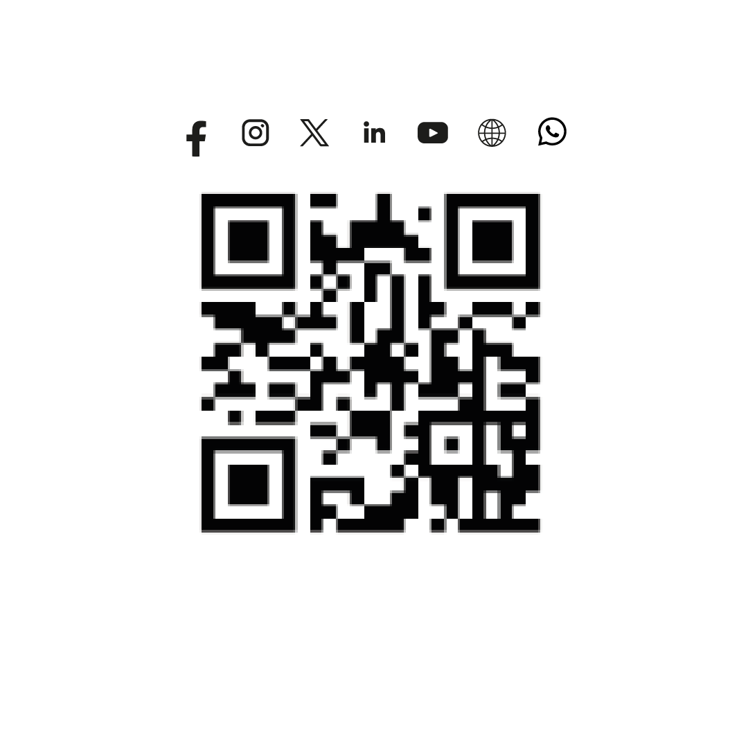
Muchas Gracias!

